Slide 1
Biological Science Genetics
Year 10 Science

Slide 2
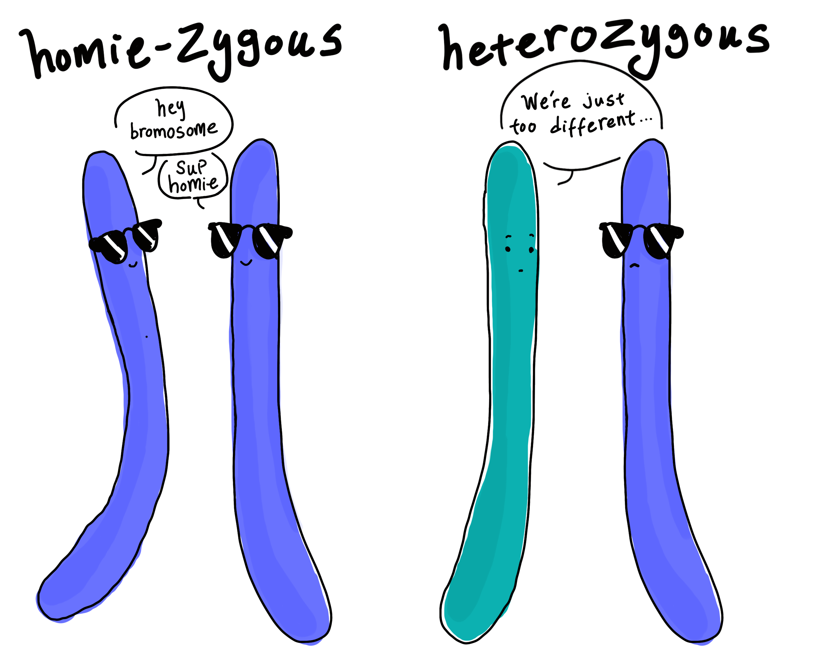
Simple Inheritance
Teacher Cue
Active tracking, choral reading
Our traits such as hair colour and height are determined by our genes.
Our genes can have variations such as blonde or brown hair.
An allele is one of two or more versions of a gene. An individual inherits two alleles for each gene, one from each parent.
If the two alleles are the same, the individual is homozygous for that gene. HH or hh
If the two alleles are different, the individual is heterozygous. Hh

Slide 3
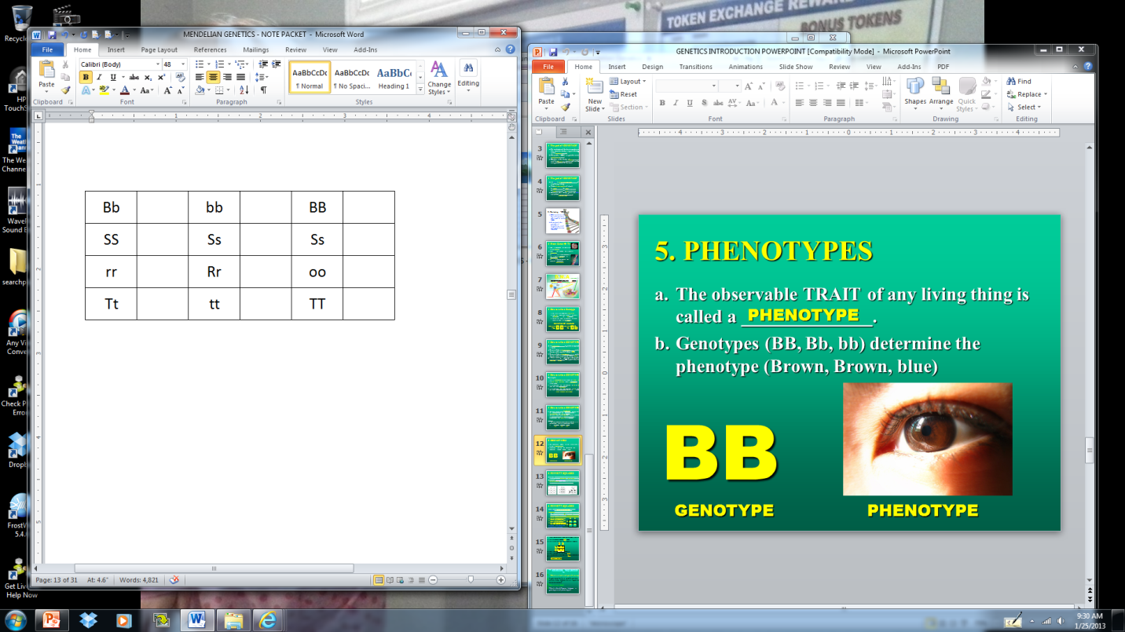
CHECK FOR UNDERSTANDING
He
Ho
Ho
For each genotype,
Indicate whether the following alleles are Heterozygous (He) or Homozygous (Ho)
Ho
He
He
Ho
He
Ho
He
Ho
Ho

Slide 4
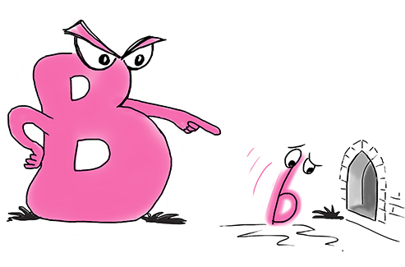
Simple Inheritance
Dominant: The form of a trait that is shown if it is present
It is symbolised with a capital letter.
Example: Tall = T
Recessive: The form of a trait that is only shown if a dominant allele is absent. If dominant is present, recessive is hidden. Lower case letter.
Example: Short = t

Slide 5
CHECK FOR UNDERSTANDING
Pp
Indicate whether the following alleles are:
Heterozygous
Homozygous Dominant
Homozygous Recessive
bb
BB
Bb
mm
AA

Slide 6
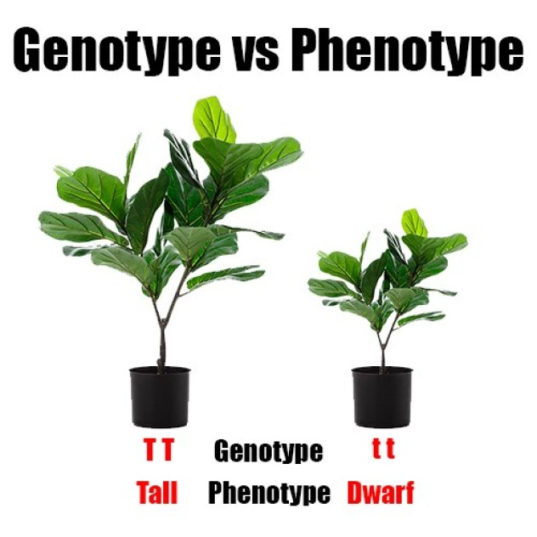
Simple Inheritance
Genotype:
The genetic makeup of a trait. (The code)
Examples: TT, Tt, tt
Phenotype:
Physical appearance (what you see!)
Tall or short, blue eyes or brown eyes, green or yellow

Slide 7
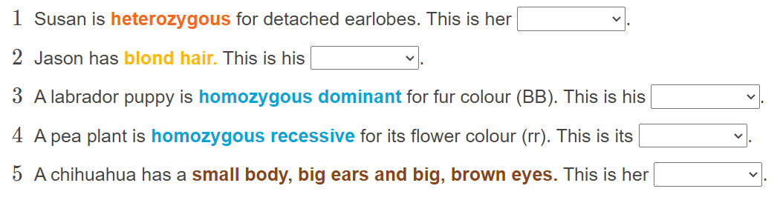
Classify each of the following as either Genotype or Phenotype

Slide 8
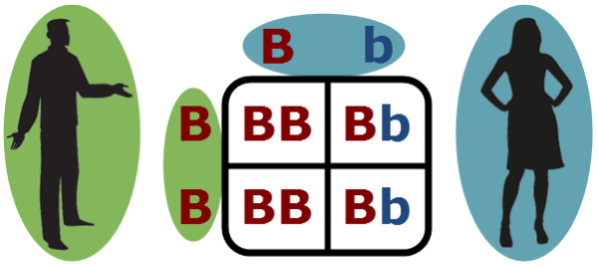
Simple Inheritance
Teacher Cue
Active tracking, choral reading
Punnett squares are used to show all of the possible genotypes that offspring could have and how likely each genotype is to occur.
One parent’s alleles are placed on top of the Punnett square. The other parent’s alleles are placed on the left of the Punnett square.
In the centre of the Punnett square are the results of fertilization and show the different allele combinations that the children could have.

Slide 9
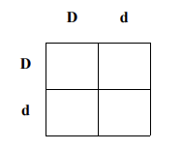
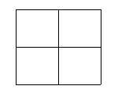
Fill in the following Punnett squares
RR x Rr

Slide 10
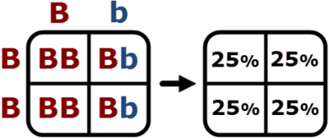
Simple Inheritance
Teacher Cue
Active tracking, choral reading
Punnett squares can be used to find the probability of genotypes and phenotypes in offspring.
Each box is a quarter, which means it has a 25% chance of occurring.
To show the probability of genotypes:
List out all possible genotypes
Add up their percentages and write next to each.
To show the probability of phenotypes:
List out all possible phenotypes
Look at your genotypes. Use these to write what you would see!
B = brown eyes
b = blue eyes
B = brown eyes
b = blue eyes
BB = 50% Bb = 50%
Bb = 0%
Brown Eyes: 100%
Blonde Eyes: 0%

Slide 11
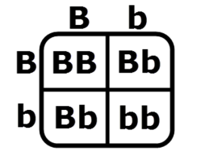
1. Use the Punnett square below to calculate the probability that a particular offspring will have the genotype bb
25%

Slide 12
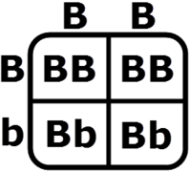
2. Use the Punnett square below to calculate the probability that a particular offspring will have the genotype BB.
50%

Slide 13
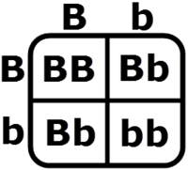
3. A gene controlling eye colour has a dominant allele for brown eyes (B) and a recessive allele for blue eyes (b).
Use the Punnett square below to calculate the probability that a particular offspring will be brown eyed.
75%

Slide 14
4. The allele for brown eyes (B) is dominant the allele for blue eyes (b) is recessive.
Use the Punnett square below to calculate the probability that a particular offspring will be blue eyed.
0%

Slide 15
5. The allele for brown eyes (B) is dominant over the allele for blue eyes (b).
Use the Punnett square below to calculate the probability that a particular offspring will be brown eyed.
100%

Slide 16
Sex-Linked Traits
Teacher Cue
Active tracking, choral reading
Humans typically have 23 pairs of chromosomes.
The first 22 pairs of chromosomes are called autosomes. They are the same in males and females.
The last pair of chromosomes are the sex chromosomes.
Females have two X chromosomes: XX
Males have an X and a Y chromosome: XY
Some traits are inherited in different ratios for males and females. This is because the genes that cause them are found on one of the sex chromosomes. This is called sex-linked inheritance.
For example, the inheritance of red-green colour vision deficiency is sex-linked. The gene that causes it is on the X chromosome.

Slide 17
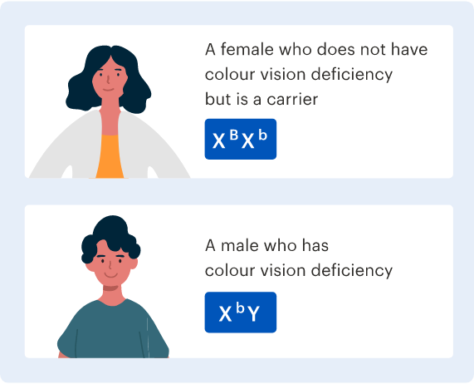
Sex-Linked Traits
Teacher Cue
Active tracking, choral reading
Sex-Linked Punnett Squares are very similar to the one’s you did earlier. We just need to change our symbols!
Example: Colour Vision Deficiency
X^{B} is the dominant allele for "normal" colour vision
X^{b} is the recessive allele for colour vision deficiency
Y is the male sex chromosome, which doesn't contain this gene and has no impact on colour vision.

Slide 18
Colorblindness is a recessive, sex-linked disorder in humans. A colorblind man has a child with a woman who is a carrier of the disorder.
KEY: X^{N} = normal vision X^{n} = colorblindness
What is the genotype of the man? ___________
What is the genotype of the woman? _____________
Fill in the Punnett Square to the right.
What is the chance that the child will be colorblind? _________
What is the chance that a daughter will be colorblind? __________
What is the chance that a son will be colorblind? ____________

Slide 19
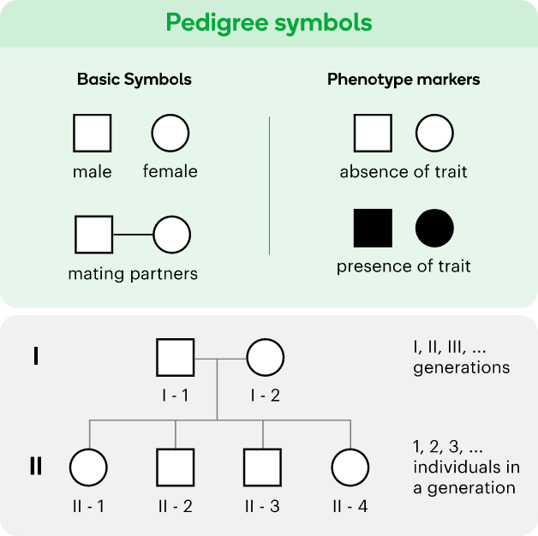
Sex-Linked Traits
Teacher Cue
Active tracking, choral reading
Family trees that are used to show how traits pass through generations are called pedigrees.
In a pedigree, each person in a family tree is replaced by a symbol – a square if they're male and a circle if they're female. When someone has the trait we're interested, their symbol is filled in.
When two people have children together, a horizontal line is drawn to connect the two symbols and their children are drawn in a separate row underneath.

Slide 20
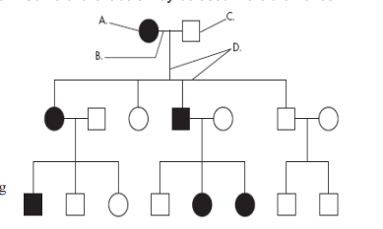
Answer the questions below using the letters: A, B, C, or D. Some labels may be used more than once.
A male ______
A female _____
A marriage _____
A person who expresses the trait ______
A person who does not express the trait _____
A connection between parents and offspring _____

Slide 21
